Slide 1

Collaboration Diagram

Slide 2
COLLABORATION DIAGRAM
The Collaboration Diagram in UML is also called a communication diagram.
The purpose of a collaboration diagram is to emphasize structural aspects of a
system, i.e., how various lifelines in the system connects.

Slide 3
UML Collaboration Diagram
The collaboration diagram is used to show the relationship between the objects in a system.
Both the sequence and the collaboration diagrams represent the same information but differently. Instead of showing the flow of messages, it depicts the architecture of the object residing in the system as it is based on object-oriented programming.
An object consists of several features. Multiple objects present in the system are connected to each other. The collaboration diagram, which is also known as a communication diagram, is used to portray the object's architecture in the system.

Slide 4
Notations of a Collaboration Diagram
Objects: The representation of an object is done by an object symbol with its name and class underlined, separated by a colon. In the collaboration diagram, objects are utilized in the following ways:
The object is represented by specifying their name and class.
It is not mandatory for every class to appear.
A class may constitute more than one object.
In the collaboration diagram, firstly, the object is created, and then its class is specified.
To differentiate one object from another object, it is necessary to name them.

Slide 5
Notations of a Collaboration Diagram
Actors: In the collaboration diagram, the actor plays the main role as it invokes the interaction. Each actor has its respective role and name. In this, one actor initiates the use case.

Slide 6
Notations of a Collaboration Diagram
Links: The link is an instance of association, which associates the objects and actors. It portrays a relationship between the objects through which the messages are sent.
it is represented by a solid line. The link helps an object to connect with or navigate to another object, such that the message flows are attached to
links.

Slide 7
Notations of a Collaboration Diagram
4.Messages: It is a communication between objects which carries information and includes a sequence number, so that the activity may take place.
It is represented by a labeled arrow, which is placed near a link. The messages are sent from the sender to the receiver, and the direction must be navigable in that particular direction.
The receiver must understand the message.

Slide 8
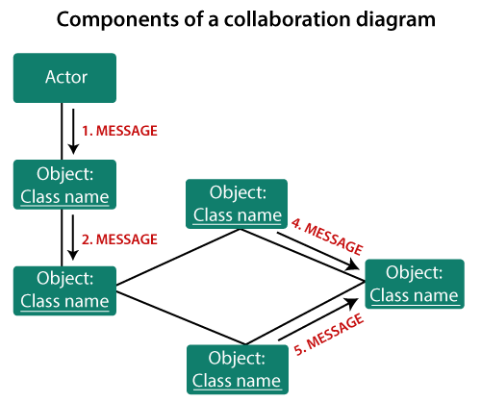
COMPONENTS OF A COLLABORATION DIAGRAM

Slide 9
When to use a Collaboration Diagram?
The collaborations are used when it is essential to depict the relationship between the object.
Both the sequence and collaboration diagrams represent the same information,
but the way of portraying it quite different. The collaboration diagrams are best suited for analyzing use cases.
Following are some of the use cases enlisted below for which the collaboration diagram is implemented:Concepts in Java
To model collaboration among the objects or roles that carry the functionalities of use cases and operations.
To model the mechanism inside the architectural design of the system.
To capture the interactions that represent the flow of messages between the objects and the roles inside the collaboration.
To model different scenarios within the use case or operation, involving a collaboration of several objects and interactions.
To support the identification of objects participating in the use case.
In the collaboration diagram, each message constitutes a sequence number, such that the top-level message is marked as one and so on.

Slide 10
Iterating and Conditional Messages
Collaboration diagrams use syntax similar to sequence diagrams to indicate that either a message iterates (is run multiple times) or is run conditionally.
You can indicate that a particular message iterates by prefixing a message sequence number with an iteration expression. You can simply use an asterisk (*) to indicate that a message runs more than once, or you can get more specific and show the number of times a message is repeated

Slide 11
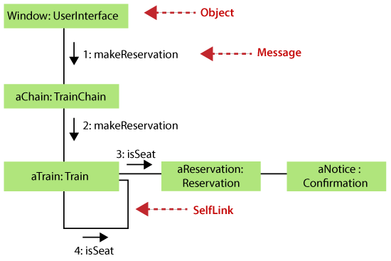
use of self in messages

Slide 12
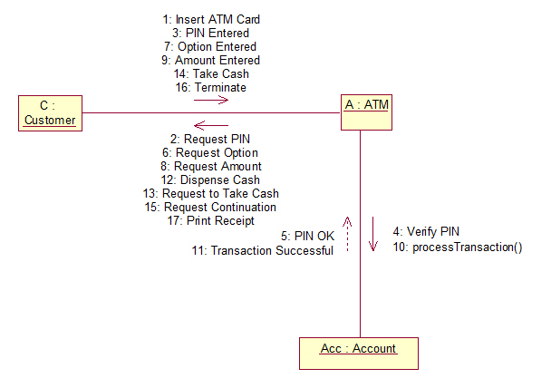
COLLABORATION diagram for ATM application

Slide 13
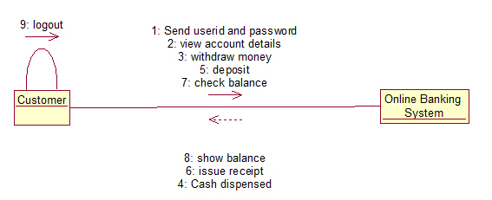
COLLABORATION diagram for ONLINE Banking System

Slide 14
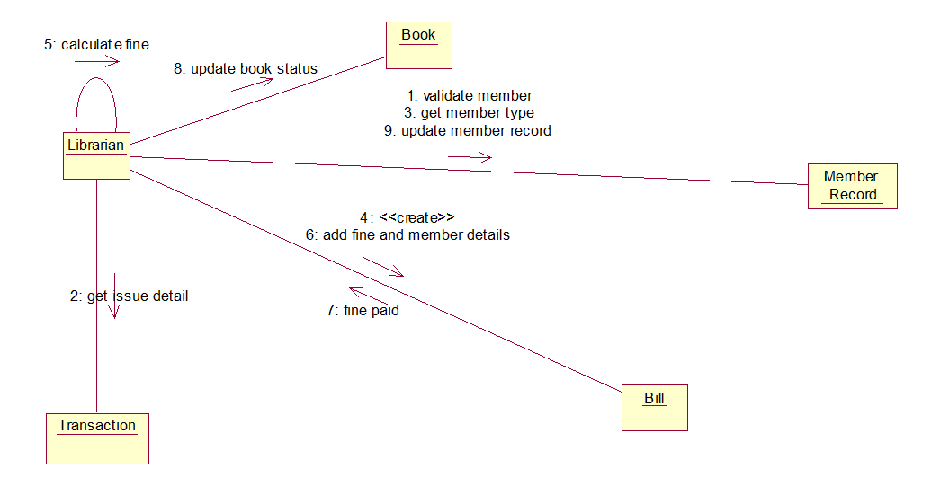
COLLABORATION diagram for Library management System

Slide 15
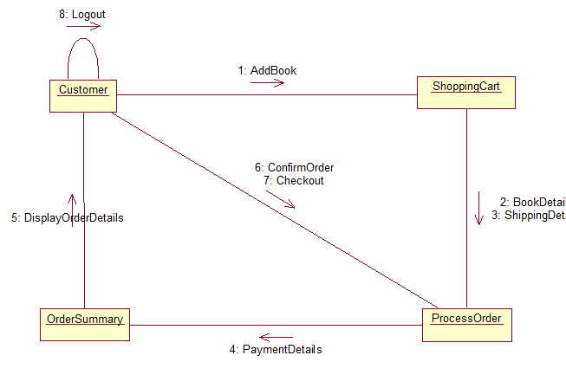
COLLABORATION diagram for ONLINE BOOK SHOP

Slide 16
The drawback of a Collaboration Diagram
Multiple objects residing in the system can make a complex collaboration diagram, as it becomes quite hard to explore the objects.
It is a time-consuming diagram.
After the program terminates, the object is destroyed.
As the object state changes momentarily, it becomes difficult to keep an eye on every single that has occurred inside the object of a system.

Slide 17
THANK YOU

